Slide 1
CAE Final Report
Improvement of the arm in the suspension system of an electric vehicle.
21800330 박현의
21900416 안견힐
21900793 한태건

Slide 2
CONTENTS
Introduction (issue)
Conditions (Boundary, Contact, Force)
New Arm Modeling
Mesh
Static Analysis
Result & Discussion

Slide 3
PART 1.
Introduction (Issue)

Slide 4
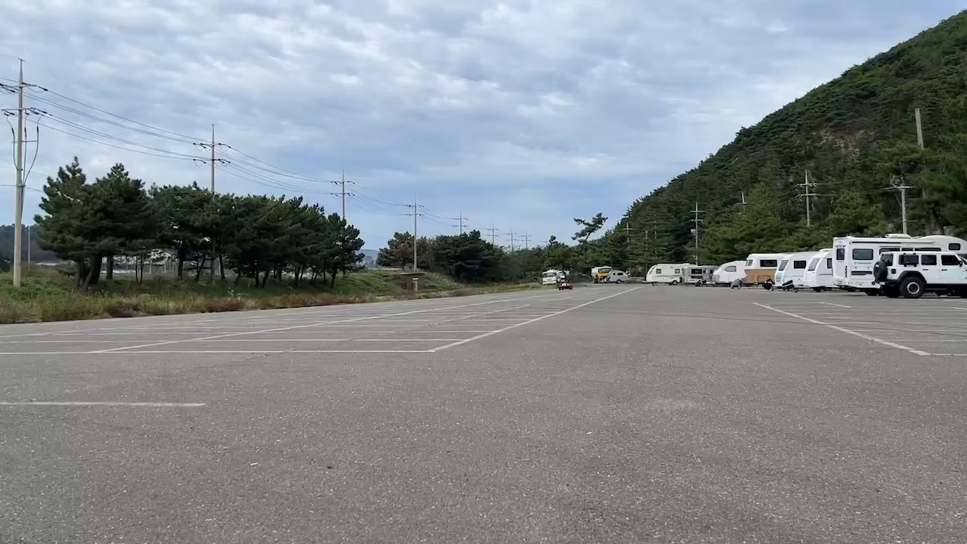
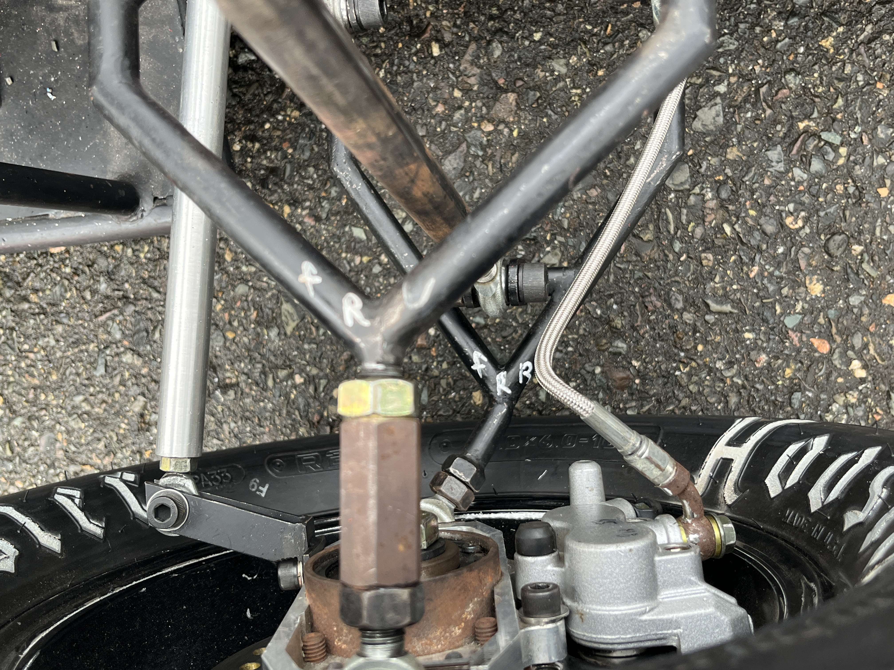
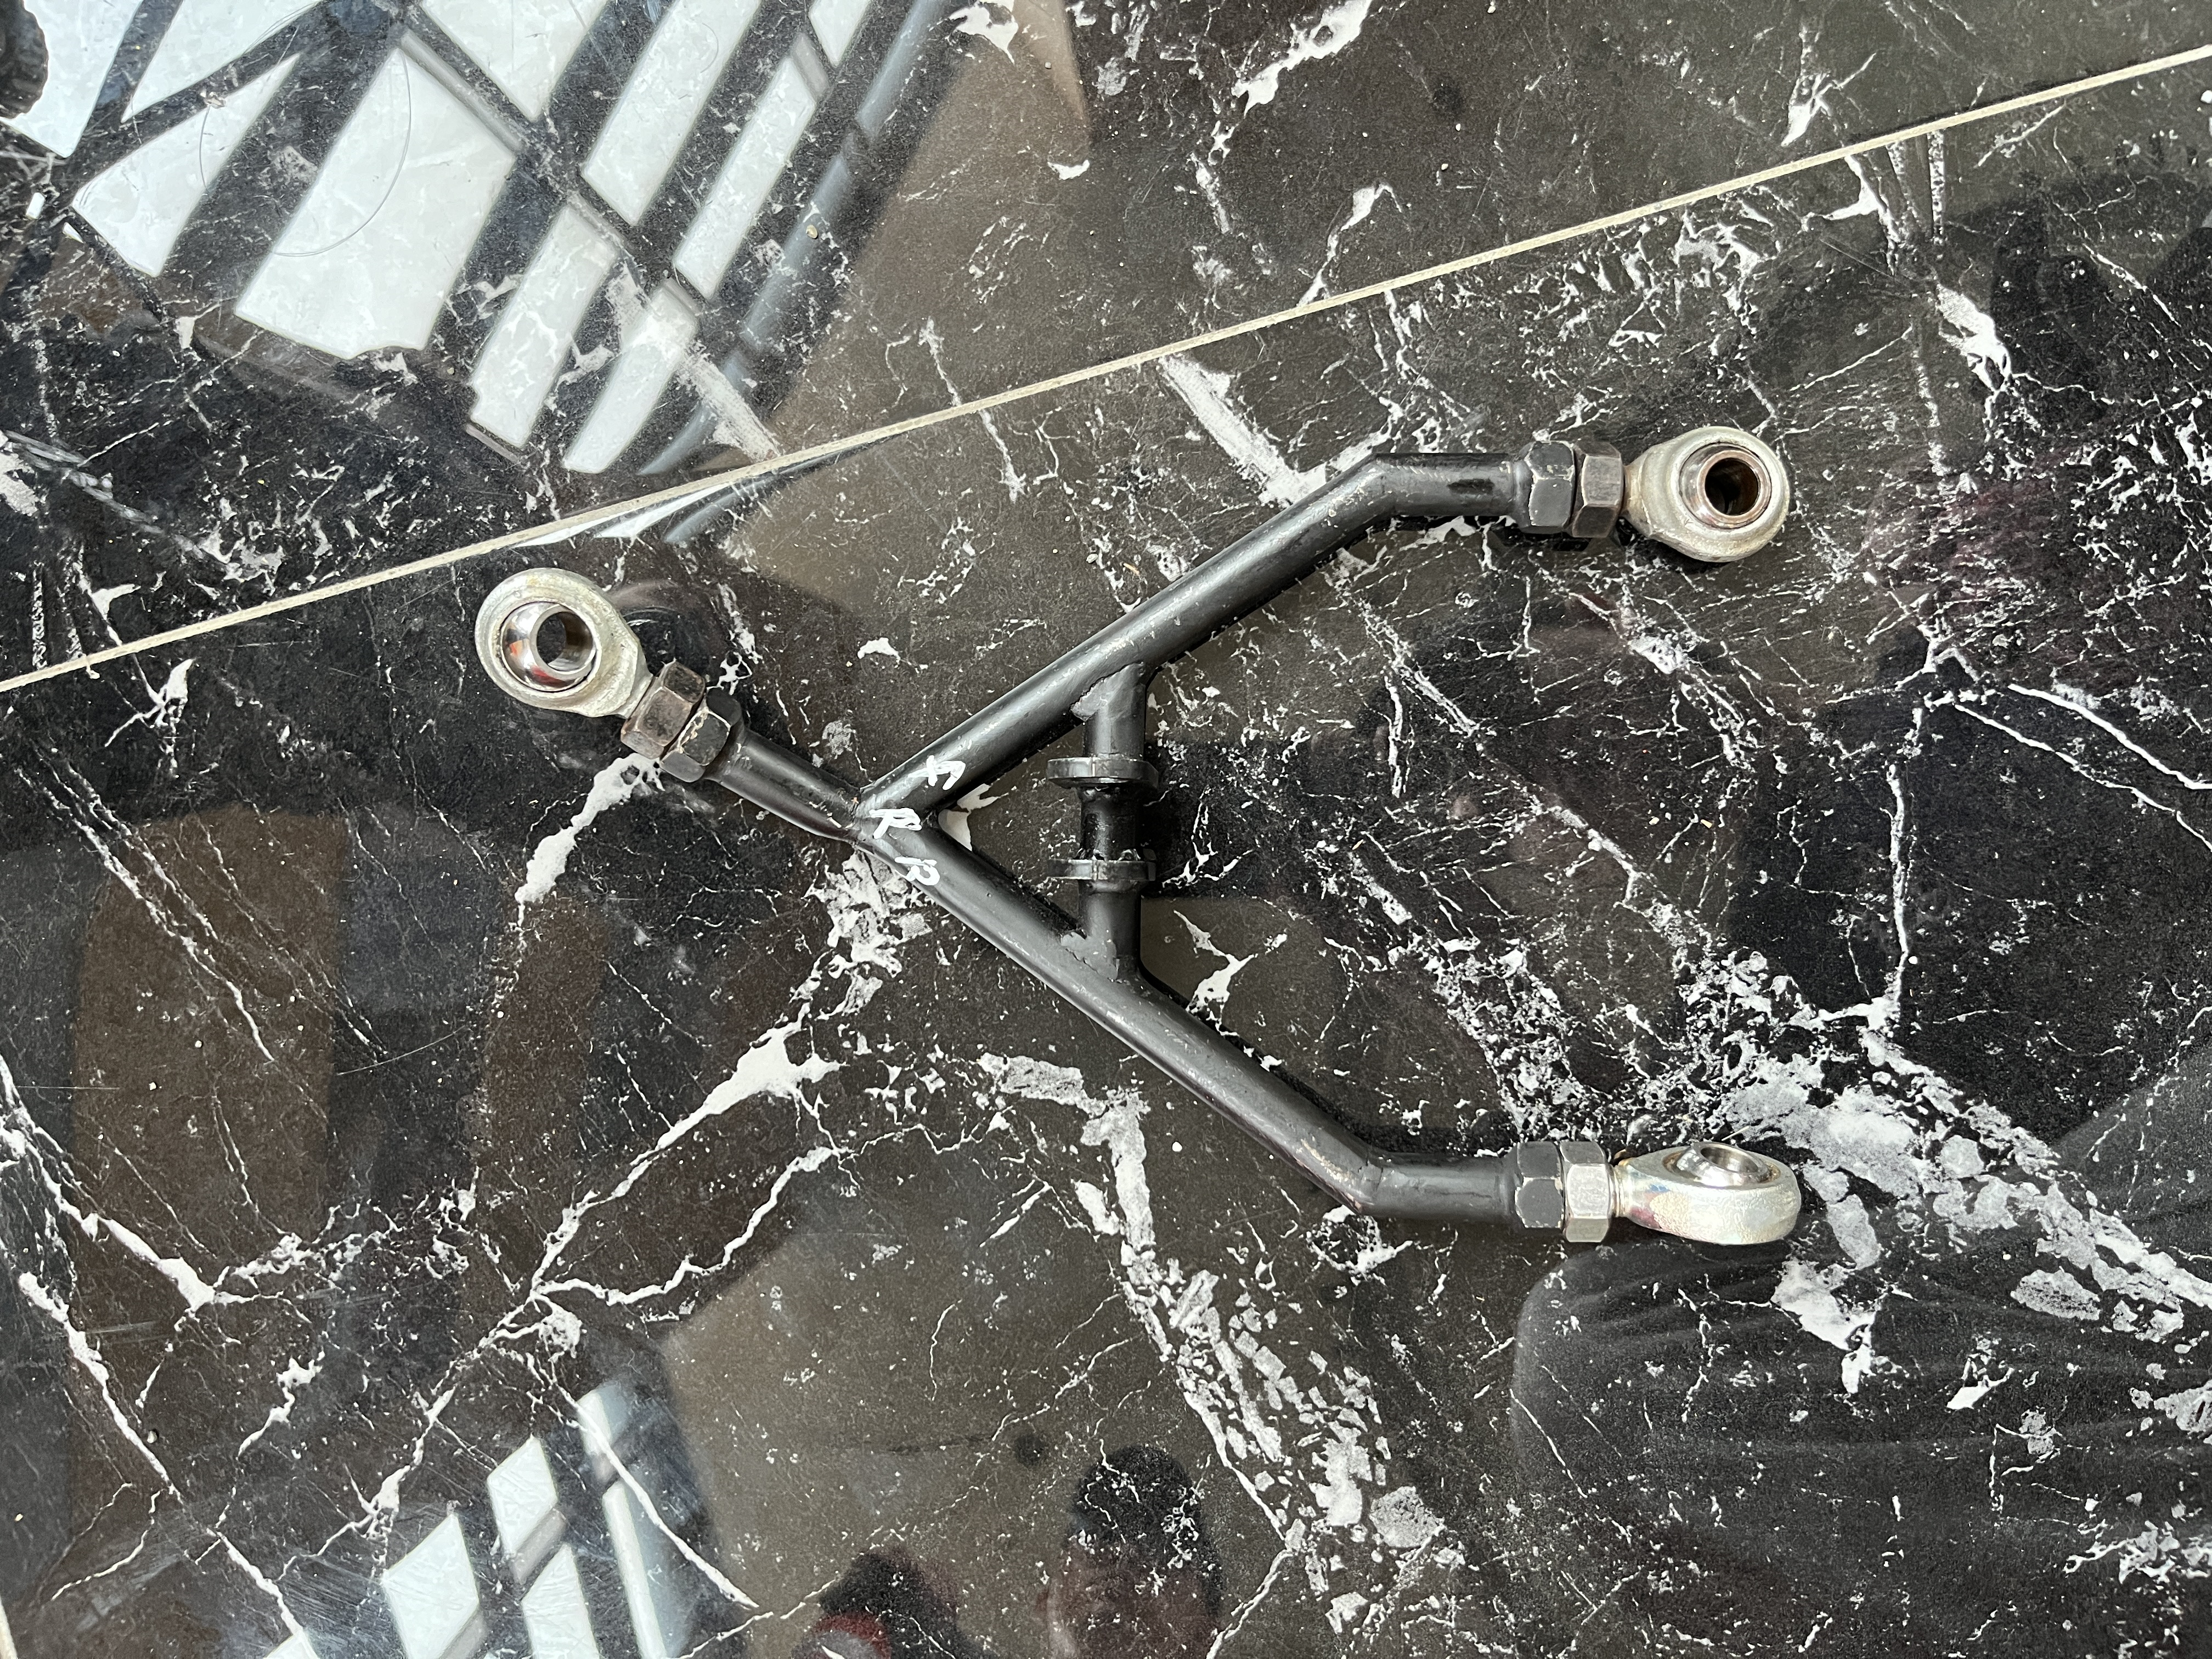
1. Issue
PART 2.
PART 3.
PART 4.
PART 5.
A strong force is applied to the arm during a sudden connering of the vehicle, causing bending force to act
(차량 코너링시 암에 강한 굽힘힘이 작용하여 휘는 현상이 발생함)

Slide 5
PART 2. Conditions

Slide 6
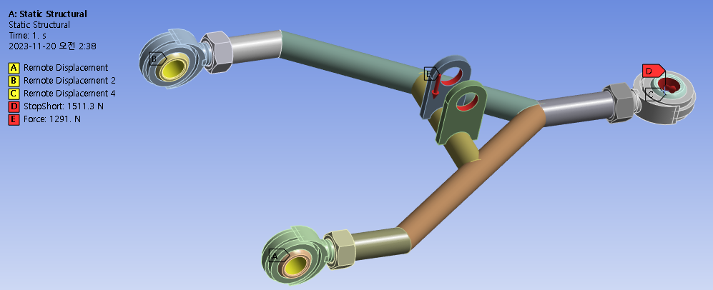
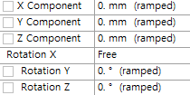
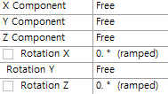
1. Boundary Condition
PART 1.
2. Conditions
PART 3.
PART 4.
PART 5.

Slide 7
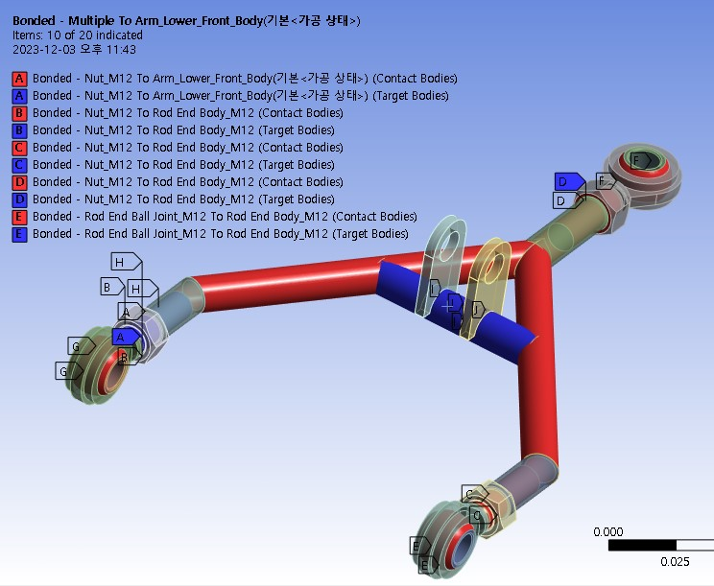
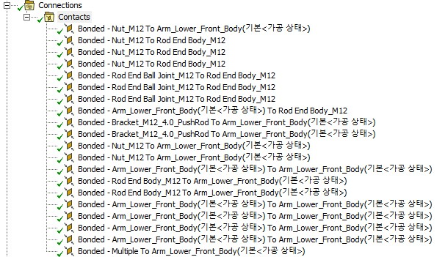
2. Contact Condtion
PART 1.
2. Conditions
PART 3.
PART 4.
PART 5.

Slide 8
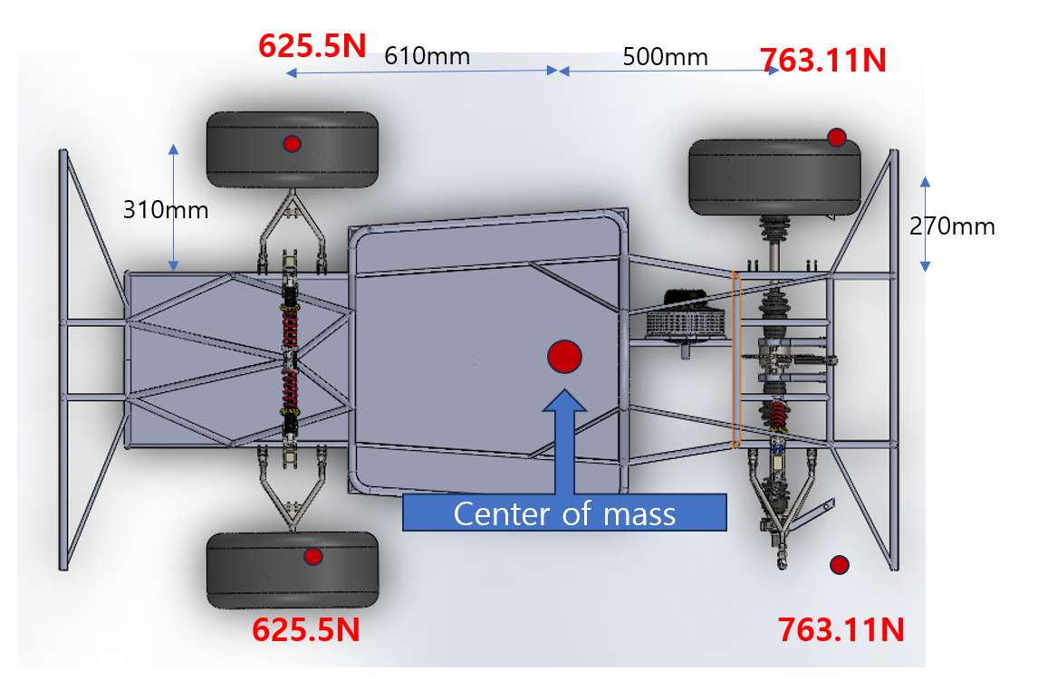
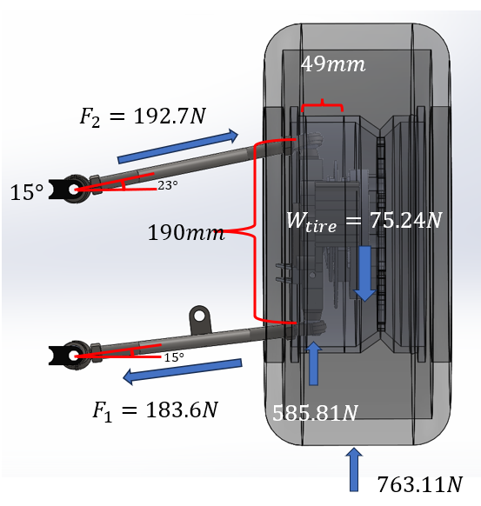
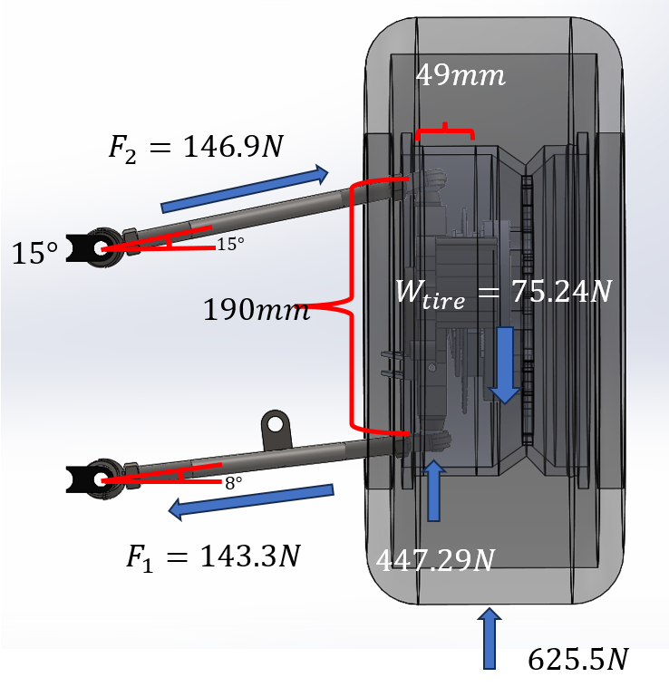
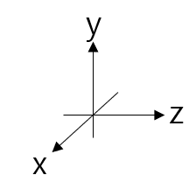
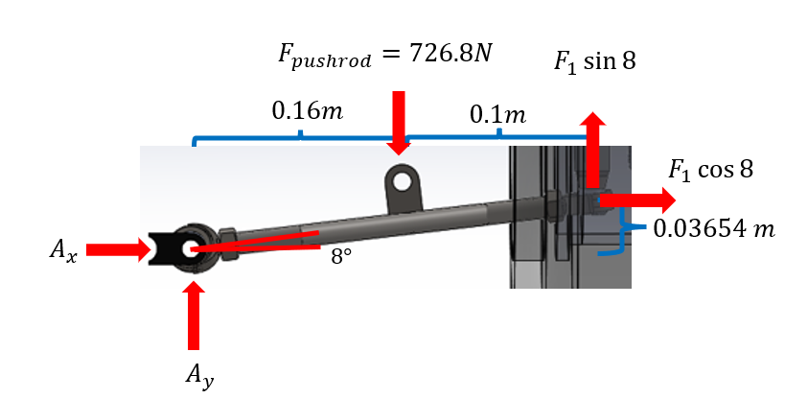
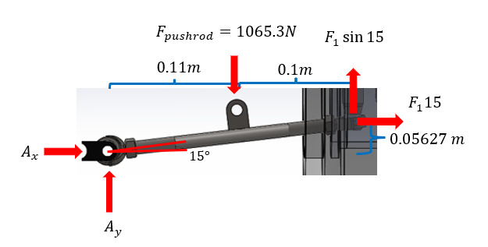
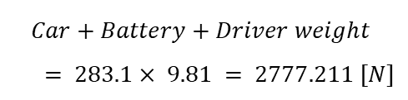
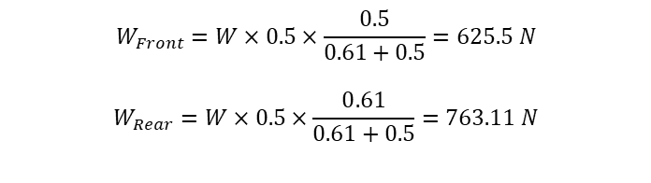
3-1. Force Condition – Linear Acceleration
PART 1.
2. Conditions
PART 3.
PART 4.
PART 5.
< 차량 하중 계산 >
Calculation of load distribution
Front
Rear
$$Car+Battery+Driver weight$$
$$= 283.1× 9.81 = 2777.211 [N]$$
$$W_{Front}=W×0.5×\frac{0.5}{0.61+0.5}=625.5 N$$
$$W_{Rear}=W×0.5×\frac{0.61}{0.61+0.5}=763.11 N$$

Slide 9
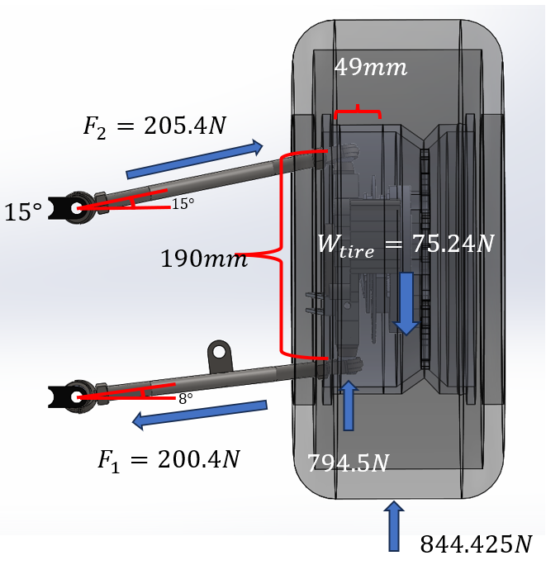
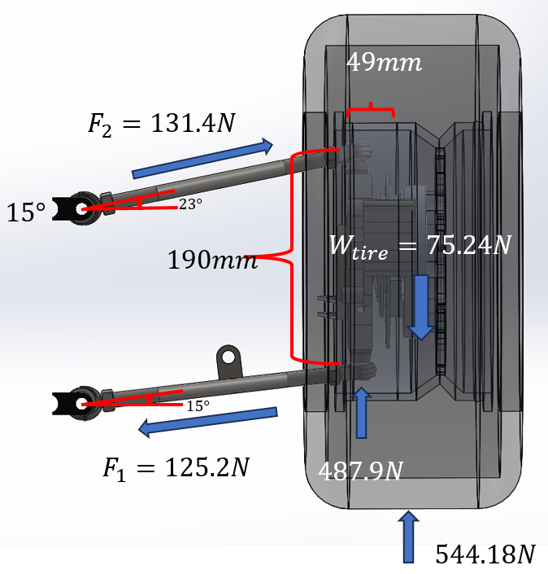
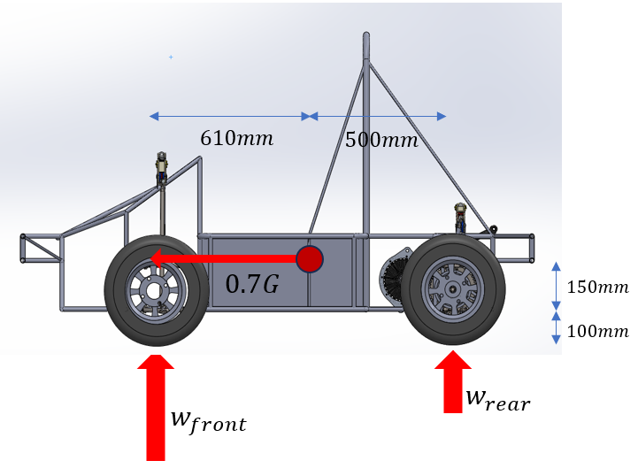
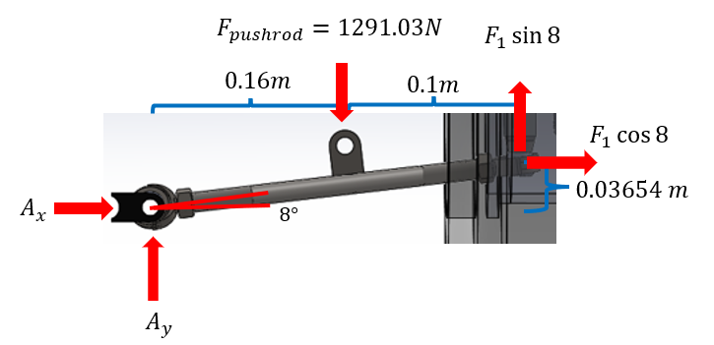
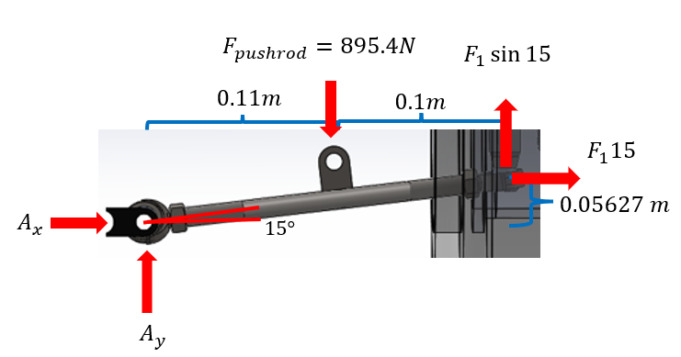
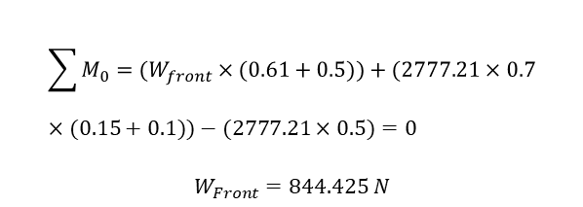
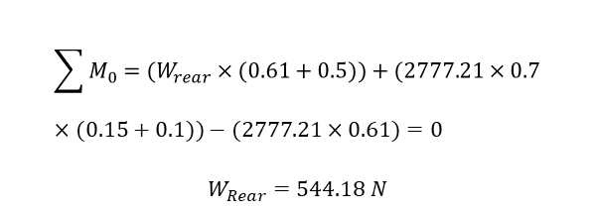
3-2. Force Condition – Sudden Stop
PART 1.
2. Conditions
PART 3.
PART 4.
PART 5.
< 차량 하중 계산 >
Calculation of load distribution
Front
Rear
$$\sum{M_{0}=(W_{front}}×(0.61+0.5))+(2777.21×0.7×(0.15+0.1))−(2777.21×0.5)=0$$
$$W_{Front}=844.425 N$$
$$\sum{M_{0}=(W_{rear}}×(0.61+0.5))+(2777.21×0.7×(0.15+0.1))−(2777.21×0.61)=0$$
$$W_{Rear}=544.18 N$$
급정거 하중 조건 : 70% 하중이 전륜에 가해짐, 마찰력에 의한 x방향 힘 고려
Emergency braking load condition: 70% of the load is applied to the front wheels, taking into account the frictional force in the x-direction.

Slide 10
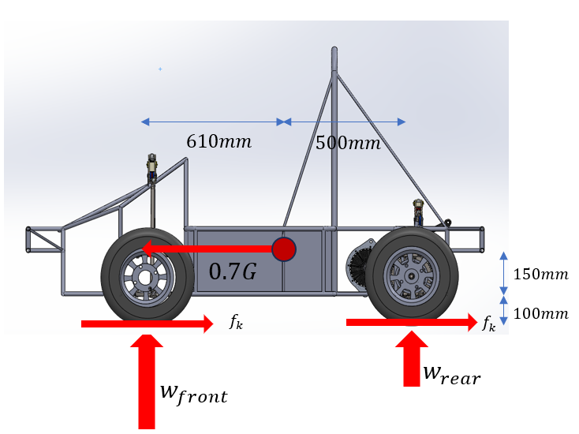
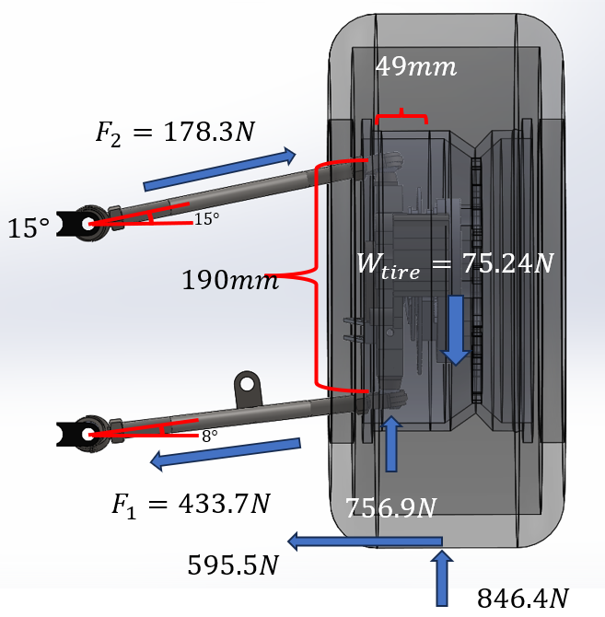
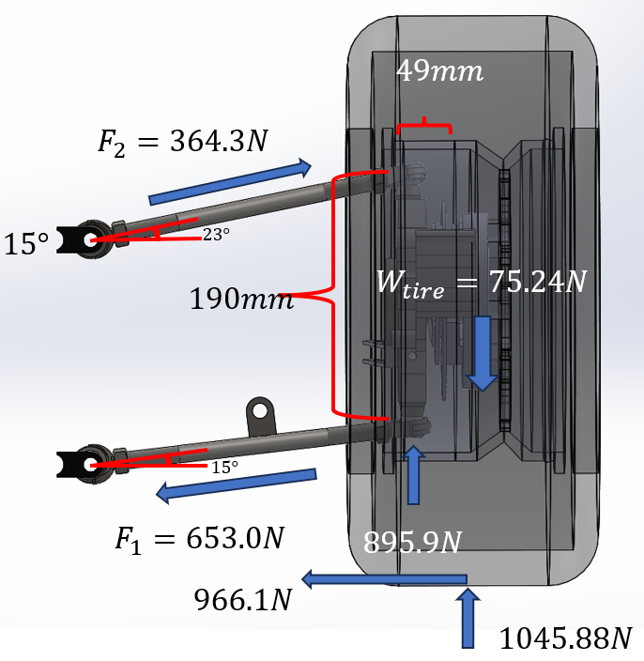
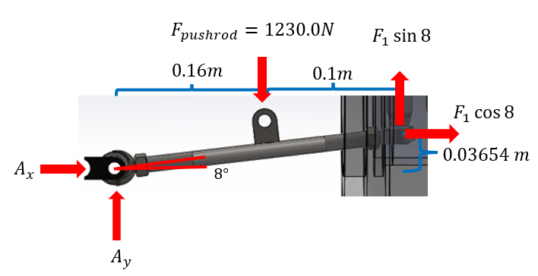
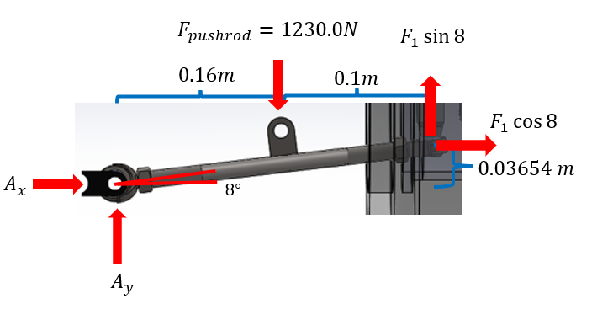
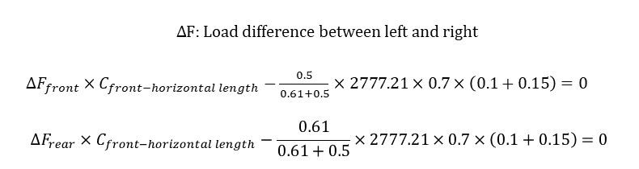
3-3. Force Condition – Cornering
PART 1.
2. Conditions
PART 3.
PART 4.
PART 5.
< 차량 하중 계산 >
Calculation of load distribution
Left_Front
Left_Rear
$∆F:$Load difference between left and right
$∆F_{front}×C_{front−horizontal length}−\frac{0.5}{0.61+0.5}×2777.21×0.7×\left(0.1+0.15\right)=0$
$$∆F_{rear}×C_{front−horizontal length}−\frac{0.61}{0.61+0.5}×2777.21×0.7×\left(0.1+0.15\right)=0$$
$$W_{front, left}=W_{front}+∆F_{front}=846.4 N$$
$$W_{front, right}=W_{front}−∆F_{front}=404.6 N$$
코너링 하중 조건 : 관성과 타이어 마찰에 의한 x, y, z 방향 힘 고려
Cornering load condition: Considering forces in the x, y, and z directions due to inertia and tire friction.
$$W_{rear, left}=W_{rear}+∆F_{rear}=1045.88 N$$
$$W_{rear, right}=W_{rear}−∆F_{rear}=480.34 N$$
(Assume to move to right)

Slide 11
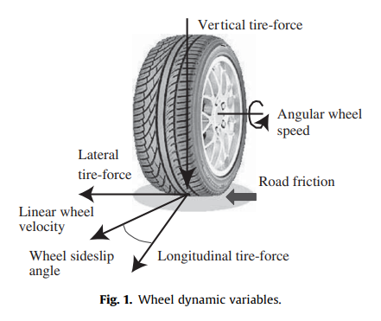
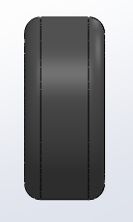
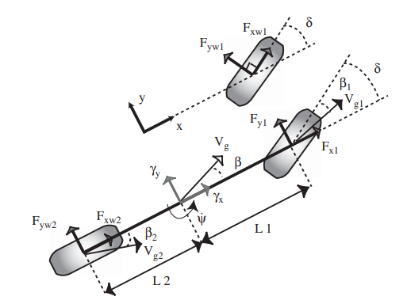
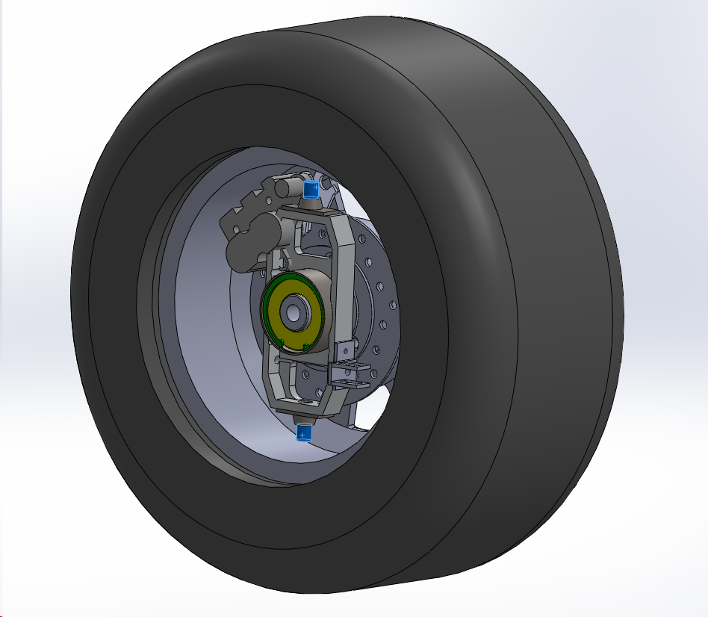




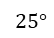


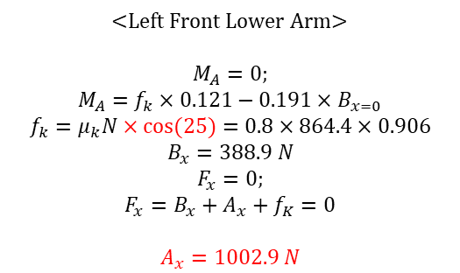

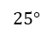

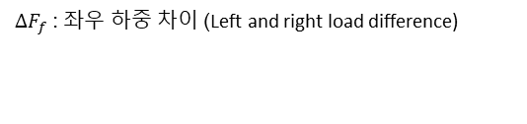
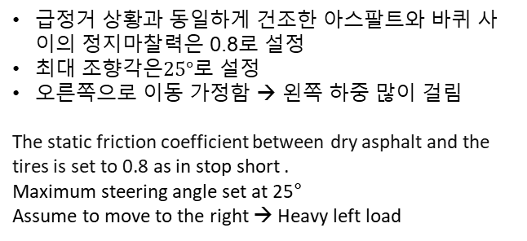
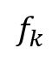
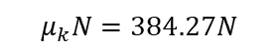

3-4. Force Condition – Cornering
PART 1.
2. Conditions
PART 3.
PART 4.
PART 5.
< 코너링 시 하중 분배 >
$$W_{F(left or right)}=W_{front}±∆F_{f}$$
$$W_{R(left or right)}=W_{Rear}±∆F_{f}$$
$$μ_{k}N=677.12N$$
$$μ_{k}N=323.68N$$
$$W_{front}=625.5 \left[N\right], W_{Rear}=763.11 \left[N\right],$$
$$25°$$
$$25°$$
$∆F_{f}$ : 좌우 하중 차이 (Left and right load difference)
급정거 상황과 동일하게 건조한 아스팔트와 바퀴 사이의 정지마찰력은 0.8로 설정
최대 조향각은$25°$로 설정
오른쪽으로 이동 가정함 → 왼쪽 하중 많이 걸림
The static friction coefficient between dry asphalt and the tires is set to 0.8 as in stop short .
Maximum steering angle set at 25°
Assume to move to the right → Heavy left load
$$μ_{k}N=836.70N$$
$$μ_{k}N=384.27N$$
<Left Front Lower Arm>
$$M_{A}=0;$$
$${M_{A}=f}_{k}×0.121−0.191×B_{x=0}$$
$$f_{k}=μ_{k}N×cos⁡(25)=0.8×864.4×0.906$$
$$B_{x}=388.9 N$$
$$F_{x}=0;$$
$$F_{x}=B_{x}+A_{x}+f_{K}=0$$
$$A_{x}=1002.9 N$$
$$B_{y}$$
$$B_{x}$$
$$A_{y}$$
$$A_{x}$$
$$f_{k}$$

Slide 12
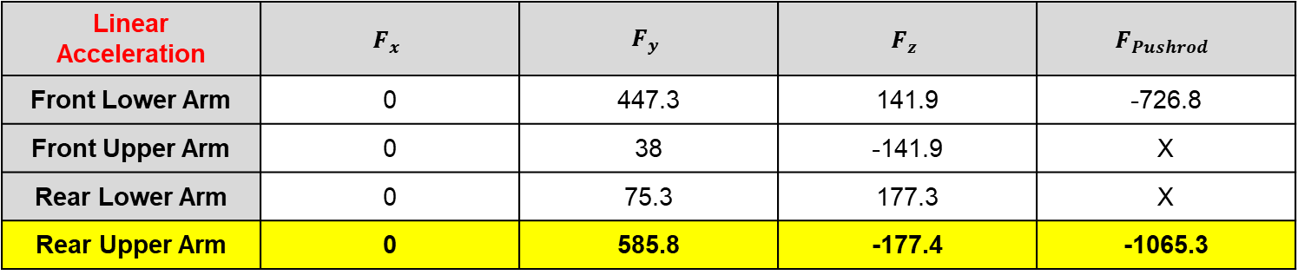
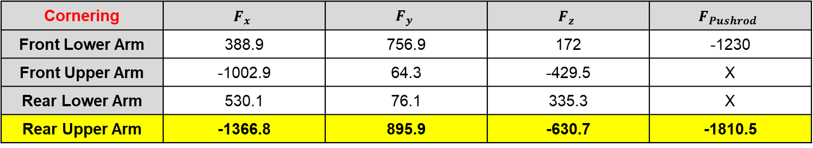
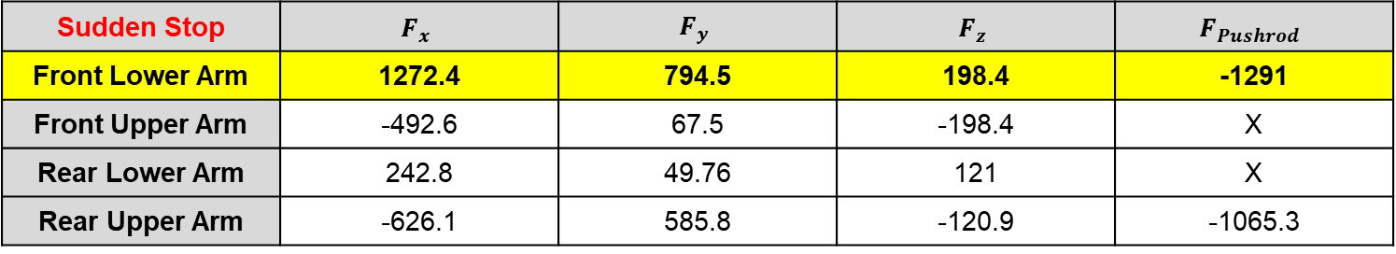
3. Force Condition
PART 1.
2. Conditions
PART 3.
PART 4.
PART 5.
Linear Acceleration | $$F_{x}$$ | $$F_{y}$$ | $$F_{z}$$ | $$F_{Pushrod}$$
Front Lower Arm | 0 | 447.3 | 141.9 | -726.8
Front Upper Arm | 0 | 38 | -141.9 | X
Rear Lower Arm | 0 | 75.3 | 177.3 | X
Rear Upper Arm | 0 | 585.8 | -177.4 | -1065.3
Sudden Stop | $$F_{x}$$ | $$F_{y}$$ | $$F_{z}$$ | $$F_{Pushrod}$$
Front Lower Arm | 1272.4 | 794.5 | 198.4 | -1291
Front Upper Arm | -492.6 | 67.5 | -198.4 | X
Rear Lower Arm | 242.8 | 49.76 | 121 | X
Rear Upper Arm | -626.1 | 585.8 | -120.9 | -1065.3
Cornering | $$F_{x}$$ | $$F_{y}$$ | $$F_{z}$$ | $$F_{Pushrod}$$
Front Lower Arm | 388.9 | 756.9 | 172 | -1230
Front Upper Arm | -1002.9 | 64.3 | -429.5 | X
Rear Lower Arm | 530.1 | 76.1 | 335.3 | X
Rear Upper Arm | -1366.8 | 895.9 | -630.7 | -1810.5

Slide 13
PART 3.
New Arm Modeling

Slide 14
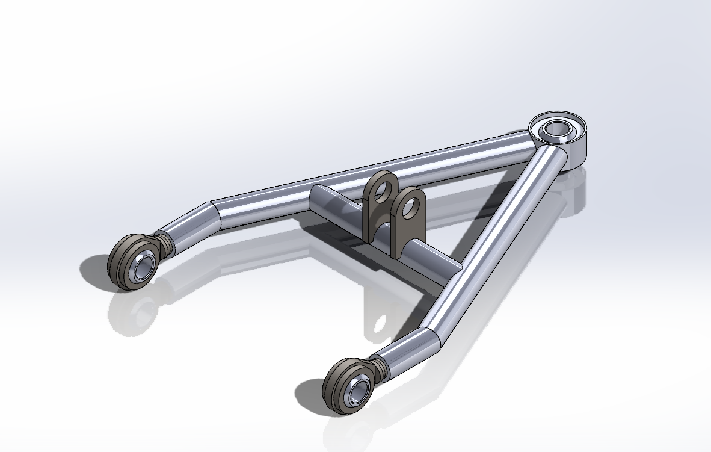
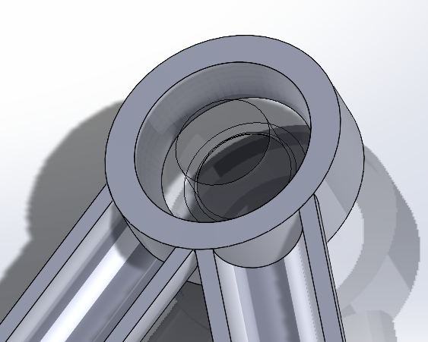
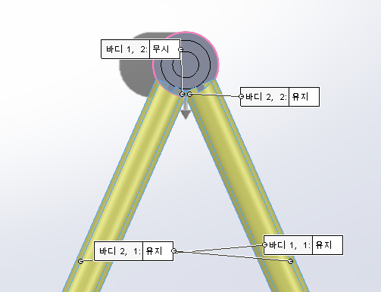
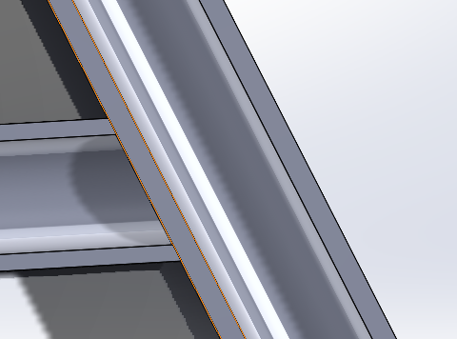
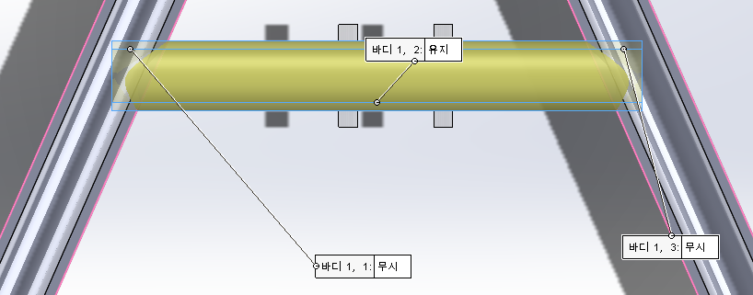
1. New Front Lower & Rear Upper Arm
PART 1.
PART 2.
3. Mesh
PART 4.
PART 5.
안정성을 고려하여 외경 15.8mm 두께 2T로 설계
Considering the safety, outer diameter is 15.8mm and thickness is 2T.
용접 구조물 편집을 통하여 불필요한 요소 제거 및 구조 단순화
Using the welded structure editter, remove the unnecessary component and make a simple structure.

Slide 15
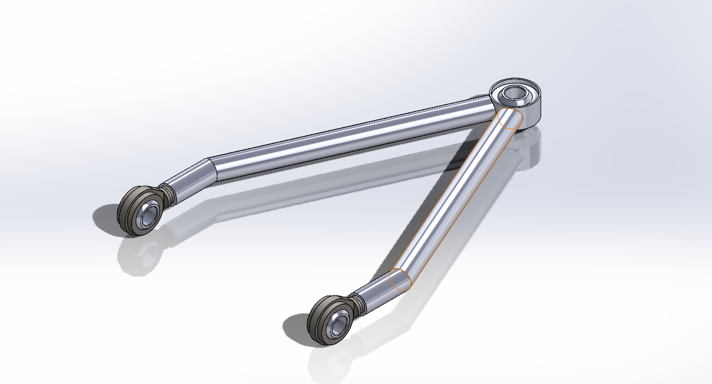
2. New Front Upper & Rear Lower Arm
PART 1.
PART 2.
3. Mesh
PART 4.
PART 5.
용접 구조물 편집을 통하여 불필요한 요소 제거 및 구조 단순화
Using the welded structure editter, remove the unnecessary component and make a simple structure.
안정성을 고려하여 외경 15.8mm 두께 2T로 설계
Considering the safety, outer diameter is 15.8mm and thickness is 2T.

Slide 16
PART 4.
Mesh

Slide 17
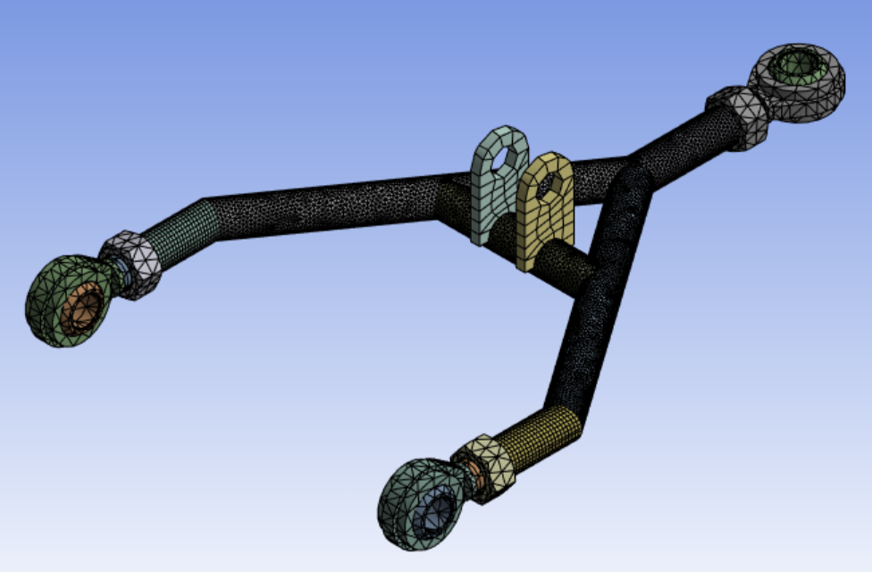






1. Mesh Quality & Method (Front Lower – old)
PART 1.
PART 2.
3. Mesh
PART 4.
PART 5.
(1) Automatic : except pipe
(2) 2.7mm : ball bearing, nut & bracket
(3) 2.5mm : ball joint
(4) 1.2mm : pipe

Slide 18







2. Mesh Quality & Method (Front Upper – old)
PART 1.
PART 2.
3. Mesh
PART 4.
PART 5.
(1) Automatic : except pipe
(2) 1.5mm : nut & tune buckle, ball joint
(4) 1.0mm: pipe
(5) 3.0mm: ball bearing

Slide 19







3. Mesh Quality & Method (Rear Lower – old)
PART 1.
PART 2.
3. Mesh
PART 4.
PART 5.
(1) Automatic : except pipe
(2) 1mm : pipe
(3) 2mm : ball bearing
(4) 2.5mm : nut
(5) 2.7mm : rod end body

Slide 20






PART 1.
PART 2.
3. Mesh
PART 4.
PART 5.
4. Mesh Quality & Method (Rear Upper – old)
(1) Automatic : Except pipe
(2) 1mm : pipe
(3) 2.5mm : ball bearing and nut
(4) 3mm : rod end body

Slide 21



5. Mesh Quality & Method (Upper – New)
PART 1.
PART 2.
3. Mesh
PART 4.
PART 5.
(1) Multi Zone : pipe
(2) 1.5mm : bracket and ball bearing
(3) Edge : contact region of pipe
(4) 5mm : rod end body

Slide 22



6. Mesh Quality & Method (Lower – New)
PART 1.
PART 2.
3. Mesh
PART 4.
PART 5.
(1) Multi Zone : pipe
(2) 1.5mm : pipe and ball bearing
(3) 5mm : rod end body

Slide 23
PART 4.
Static Analysis

Slide 24


1-1. Front Upper – Linear Acceleration
PART 1.
PART 2.
PART 3.
4. Static Analysis
PART 5.
Average = 65.2 [Mpa] – Meshing [1mm]

Slide 25


1-2. Front Upper – Sudden Stop
PART 1.
PART 2.
PART 3.
4. Static Analysis
PART 5.
Average = 228.5 [Mpa] – Meshing [1mm]

Slide 26


1-3. Front Upper – Cornering
PART 1.
PART 2.
PART 3.
4. Static Analysis
PART 5.
Average = 845.1 [Mpa] – Meshing [1mm]

Slide 27


2-1. Front Lower – Linear Acceleration
PART 1.
PART 2.
PART 3.
4. Static Analysis
PART 5.
Average = 245 [Mpa] – Meshing [1.2mm]

Slide 28


2-2. Front Lower – Sudden Stop
PART 1.
PART 2.
PART 3.
4. Static Analysis
PART 5.
Average = 1440.5 [Mpa] – Meshing [1.2mm]

Slide 29


2-3. Front Lower – Cornering
PART 1.
PART 2.
PART 3.
4. Static Analysis
PART 5.
Average = 1030.4 [Mpa] – Meshing [1.2mm]

Slide 30


3-1. Rear Upper – Linear Acceleration
PART 1.
PART 2.
PART 3.
4. Static Analysis
PART 5.
Average = 390.55 [Mpa] – Meshing [1mm]

Slide 31


3-2. Rear Upper – Sudden Stop
PART 1.
PART 2.
PART 3.
4. Static Analysis
PART 5.
Average = 839.91 [Mpa] – Meshing [1mm]

Slide 32


3-3. Rear Upper – Cornering
PART 1.
PART 2.
PART 3.
4. Static Analysis
PART 5.
Average = 1316.07 [Mpa] – Meshing [1mm]

Slide 33


4-1. Rear Lower – Linear Acceleration
PART 1.
PART 2.
PART 3.
4. Static Analysis
PART 5.
Average = 190.38 [Mpa] – Meshing [1mm]

Slide 34


4-2. Rear Lower – Sudden Stop
PART 1.
PART 2.
PART 3.
4. Static Analysis
PART 5.
Average = 277.49 [Mpa] – Meshing [1mm]

Slide 35

4-3. Rear Lower – Cornering
PART 1.
PART 2.
PART 3.
4. Static Analysis
PART 5.
Average = 562.21 [Mpa] – Meshing [1mm]

Slide 36


5-1. Front Upper(New) – Linear Acceleration
PART 1.
PART 2.
PART 3.
4. Static Analysis
PART 5.
Average = 28.55 [Mpa] – Meshing [1mm]

Slide 37


5-2. Front Upper(New) – Sudden Stop
PART 1.
PART 2.
PART 3.
4. Static Analysis
PART 5.
Average = 56.37 [Mpa] – Meshing [1mm]

Slide 38


5-3. Front Upper(New) – Cornering
PART 1.
PART 2.
PART 3.
4. Static Analysis
PART 5.
Average = 63.44 [Mpa] – Meshing [1mm]

Slide 39


6-1. Front Lower(New) – Linear Acceleration
PART 1.
PART 2.
PART 3.
4. Static Analysis
PART 5.
Average = 59.52[Mpa] – Meshing [1mm]

Slide 40


6-2. Front Lower(New) – Sudden Stop
PART 1.
PART 2.
PART 3.
4. Static Analysis
PART 5.
Average = 218.28[Mpa] – Meshing [1mm]

Slide 41


6-3. Front Lower(New) – Cornering
PART 1.
PART 2.
PART 3.
4. Static Analysis
PART 5.
Average = 104.59[Mpa] – Meshing [1mm]

Slide 42


7-1. Rear Lower(New) – Linear Acceleration
PART 1.
PART 2.
PART 3.
4. Static Analysis
PART 5.
Average = 47.74 [Mpa] – Meshing [1mm]

Slide 43


7-1. Rear Lower(New) – Sudden Stop
PART 1.
PART 2.
PART 3.
4. Static Analysis
PART 5.
Average = 36.54 [Mpa] – Meshing [1mm]

Slide 44


7-1. Rear Lower(New) – Cornering
PART 1.
PART 2.
PART 3.
4. Static Analysis
PART 5.
Average = 58.33 [Mpa] – Meshing [1mm]

Slide 45


8-1. Rear Upper(New) – Linear Acceleration
PART 1.
PART 2.
PART 3.
4. Static Analysis
PART 5.
Average = 96.10[Mpa] – Meshing [1mm]

Slide 46


8-2. Rear Upper(New) – Sudden Stop
PART 1.
PART 2.
PART 3.
4. Static Analysis
PART 5.
Average = 115.89 [Mpa] – Meshing [1mm]

Slide 47


8-3. Rear Upper(New) – Cornering
PART 1.
PART 2.
PART 3.
4. Static Analysis
PART 5.
Average = 208.72 [Mpa] – Meshing [1mm]

Slide 48
PART 5.
Result & Discussion

Slide 49







PART 1.
PART 2.
PART 3.
PART 4.
5. Result
$$σ_{y}=250 \left[Mpa\right]$$
$$σ_{ut}=460 [Mpa]$$
Linear Acceleration | $$σ_{avg}$$ | $S.F (σ_{y}$) | $$S.F (σ_{ut}\text{)}$$
Front Lower Arm | 245 | 1.02 | 1.88
Front Upper Arm | 65.2 | 3.83 | 7.06
Rear Lower Arm | 190.38 | 1.31 | 2.42
Rear Upper Arm | 390.5 | 0.64 | 1.18
Linear Acceleration | $$σ_{avg}$$ | $S.F (σ_{y}$) | $$S.F (σ_{ut}\text{)}$$
Front Lower Arm | 126.33 | 1.98 | 3.64
Front Upper Arm | 10.44 | 23.94 | 44.06
Rear Lower Arm | 13.32 | 18.76 | 24.52
Rear Upper Arm | 211.56 | 1.18 | 2.17
Sudden Stop | $$σ_{avg}$$ | $$S.F (σ_{y}\text{)}$$ | $$S.F (σ_{ut}\text{)}$$
Front Lower Arm | 1440.5 | 0.17 | 0.32
Front Upper Arm | 228.5 | 1.09 | 2.01
Rear Lower Arm | 277.49 | 0.90 | 1.66
Rear Upper Arm | 839.91 | 0.29 | 0.55
Sudden Stop | $$σ_{avg}$$ | $$S.F (σ_{y}\text{)}$$ | $$S.F (σ_{ut}\text{)}$$
Front Lower Arm | 291.15 | 0.85 | 1.58
Front Upper Arm | 60.64 | 4.12 | 7.59
Rear Lower Arm | 30.09 | 8.30 | 15.28
Rear Upper Arm | 226.93 | 1.10 | 2.03
Cornering | $$σ_{avg}$$ | $$S.F (σ_{y}\text{)}$$ | $$S.F (σ_{ut}\text{)}$$
Front Lower Arm | 1030.4 | 0.24 | 0.45
Front Upper Arm | 845.1 | 0.29 | 0.54
Rear Lower Arm | 562.21 | 0.44 | 0.82
Rear Upper Arm | 1316.07 | 0.19 | 0.35
Cornering | $$σ_{avg}$$ | $$S.F (σ_{y}\text{)}$$ | $$S.F (σ_{ut}\text{)}$$
Front Lower Arm | 243.28 | 1.03 | 1.89
Front Upper Arm | 125.97 | 1.98 | 3.65
Rear Lower Arm | 48.37 | 5.17 | 9.51
Rear Upper Arm | 394.86 | 0.63 | 1.16
< Old Version (1T) >
< New Version (1T) >

Slide 50




PART 1.
PART 2.
PART 3.
PART 4.
5. Result
$$σ_{y}=250 \left[Mpa\right]$$
$$σ_{ut}=460 [Mpa]$$
Linear Acceleration | $$σ_{avg}$$ | $S.F (σ_{y}$) | $$S.F (σ_{ut}\text{)}$$
Front Lower Arm | 76.32 | 3.28 | 6.03
Front Upper Arm | 4.97 | 50.30 | 92.55
Rear Lower Arm | 7.42 | 33.69 | 13.65
Rear Upper Arm | 141.44 | 1.77 | 3.25
Sudden Stop | $$σ_{avg}$$ | $$S.F (σ_{y}\text{)}$$ | $$S.F (σ_{ut}\text{)}$$
Front Lower Arm | 144.56 | 1.72 | 3.18
Front Upper Arm | 34.27 | 7.29 | 13.42
Rear Lower Arm | 18.45 | 13.55 | 24.93
Rear Upper Arm | 146.31 | 1.71 | 3.14
Size | $$Old Version (1T)$$ | $$New Version (2T)$$
External diameter | 13.8 mm | 15.8 mm
Inner diameter | 11.75 mm | 11.75 mm
< Arm pipe specification >
Cornering | $$σ_{avg}$$ | $$S.F (σ_{y}\text{)}$$ | $$S.F (σ_{ut}\text{)}$$
Front Lower Arm | 123.75 | 2.02 | 3.72
Front Upper Arm | 78.32 | 3.19 | 5.87
Rear Lower Arm | 36.42 | 6.86 | 12.71
Rear Upper Arm | 244.94 | 1.02 | 18.44
< New Version (2T) >

Slide 51
Discussion
The old model was changed in shape and the thickness was the same. As a result, the safety factor increased, but it was still low. Therefore, when the thickness was doubled to 2T, it can be seen that the safety factor in all situations is 1 or more.
As indicated in the table, it can be observed that all safety margin have increased by up to about 9 times.
To ensure a safety margin, even under the most heavily loaded conditions, a safety margin of greater than 1 has been secured. However, for additional safety margin, it appears that additional security measures may be needed in the actual assembly and processing.

Slide 52
Conclusion
Even through changes in shape alone, it can be confirmed that the magnitude of stress on the arm varies. This emphasizes the importance of arm design.
To ensure a safety margin, an arm with an outer diameter of 15.8mm and thickness of 2T was utilized. This ensures a high level of safety.
There are limitations to ensuring safety margins through changes in shape and thickness. It is necessary to reinforce these aspects through other factors during the actual assembly.

